Slide 1
Analysing Algorithmic Patterns Based on Real Coding Interview Questions
By Ian Dempsey Supervisor: Dr.Hao Wu
Notes:
Hi and welcome to my presentation on my Masters’ Project and Thesis, titled:. My supervisor was Dr. Hao Wu.

Slide 2
Outline
Introduction.
The Problem.
Software Framework.
Methodology.
Concrete Example.
Results.
Conclusions & Future Work.
Notes:
I will be covering the following topic areas, followed by some brief questions and a short demo.

Slide 3
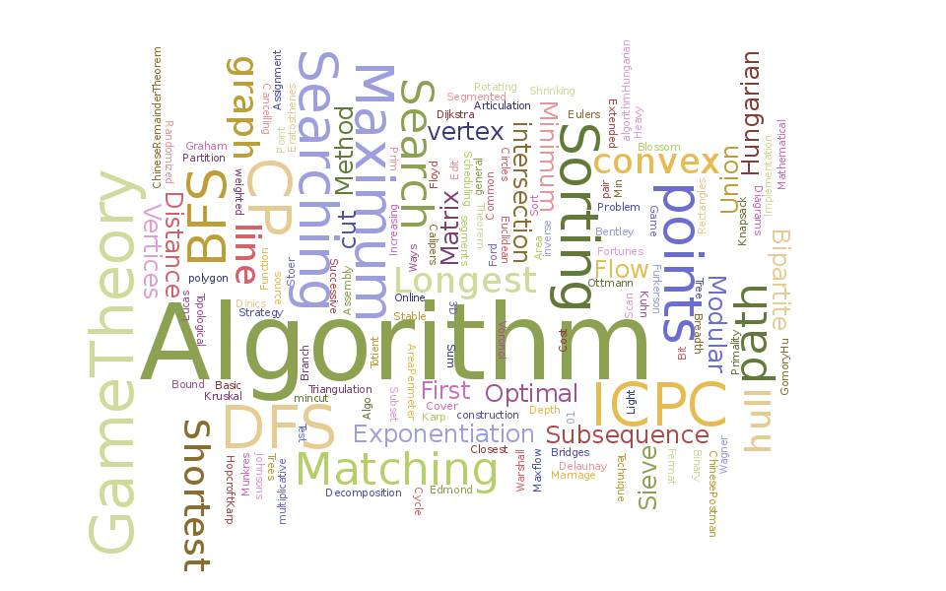
Introduction
Motivation
Interviews are becoming more technical.
Discover a more efficient form of preparation.
Contributions
Mastering the fundamental algorithms is important.
Identify the patterns of these algorithms.
Provide a guidance for programmers to better their abilities and prepare them for real world interview questions.
Notes:
The motivation behind this thesis is that we found interviews are becoming more technical.
Many companies are using technical tests to examine potential employees.
These tests usually have a whiteboarding section. These can be quite stressful as the candidate must code freely in front of experienced programmers on a wide range of topics.
To prepare for this test, people usually prepare as many questions as possible. This is very time consuming though and difficult as they need to revise topics numerous times.
Therefore, we wanted to discover if there is a more efficient way to prepare for interviews.

Slide 4

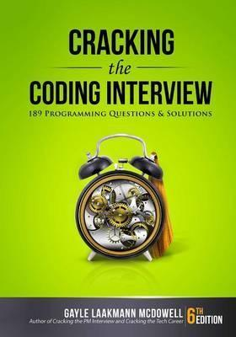
The Problem
Problem
Preparing questions is time consuming.
Related works were good, but limiting.
Try to show the flexibility of algorithms.
Reinforce material programmers know.
Research Questions
What algorithms to choose.
How do the questions relate to these algorithms.
How easily can a person identify which algorithmic pattern to apply to a question.
Algorithms
Palindrome | Merge Sort
Binary Search | Tree Traversal
Breadth-First Search | Depth-First Search
Dynamic Programming
Notes:
The Problem:
Preparing many questions before an interview can be quite time consuming. It is hard for interviewees to remember all the material that they would cover when answering these questions.
Even preparatory books are limited. They simply show readers a brief description of algorithms, some questions on a section and their solutions. They do not reinforce material that readers would already have studied.
This is limiting the candidates’ ability to think of different solutions in different ways.
We want to discover if the interview questions can be tied back to the material that a programmer would have covered during an Algorithms and Data Structures course., such as CS210 & CS211 here in Maynooth University.
Our goal is to show the reader that being comfortable with the algorithms and their patterns will result in them being flexible in thought, such that they can apply standard algorithms to a variety of questions.
Research Qs:
This then lead us to develop 3 Research Qs that attempt to solve the problem of helping interviewees prepare for interviews efficiently.
Q1. What standard algorithms do we choose to focus on. We gathered information from books such as Cracking the Coding Interview by Gayle Lackmann, online forums discussing interview experiences and algorithms books.
We chose the Algorithms in the table below.
Q2. How do the questions relate to these algorithms and their patterns. We wanted to obtain a numerical value for the similarity.
Q3. How easy can a person identify which algorithmic pattern to apply to a question.

Slide 5

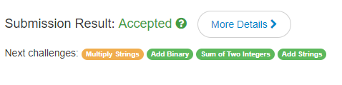
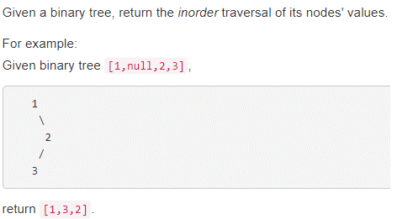
Software Framework
Online Repositories.
Active community.
Online judge system. Important.
Wide range of questions.
Java.
Notes:
We chose LeetCode as the question bank.
This is because it had some important qualities.
There is an active community. There were new questions added regularly, new test cases were validated and a forum to help people with issues or just general discussion of solutions.
There existed an online judge system. This meant that any bias that we might have had was nullified. Our solutions would only be accepted if they passed their test cases.
We wanted a wide range of questions to choose from. This meant we could choose from varied types of questions to gather our data.
For this project we chose Java as the language. Any language would have been acceptable really as we are only giving pseudocode which shows the abstracted ideas of the patterns. LeetCode is compatible with major languages like C# and Python. It even supports newer languages like Kotlin.

Slide 6
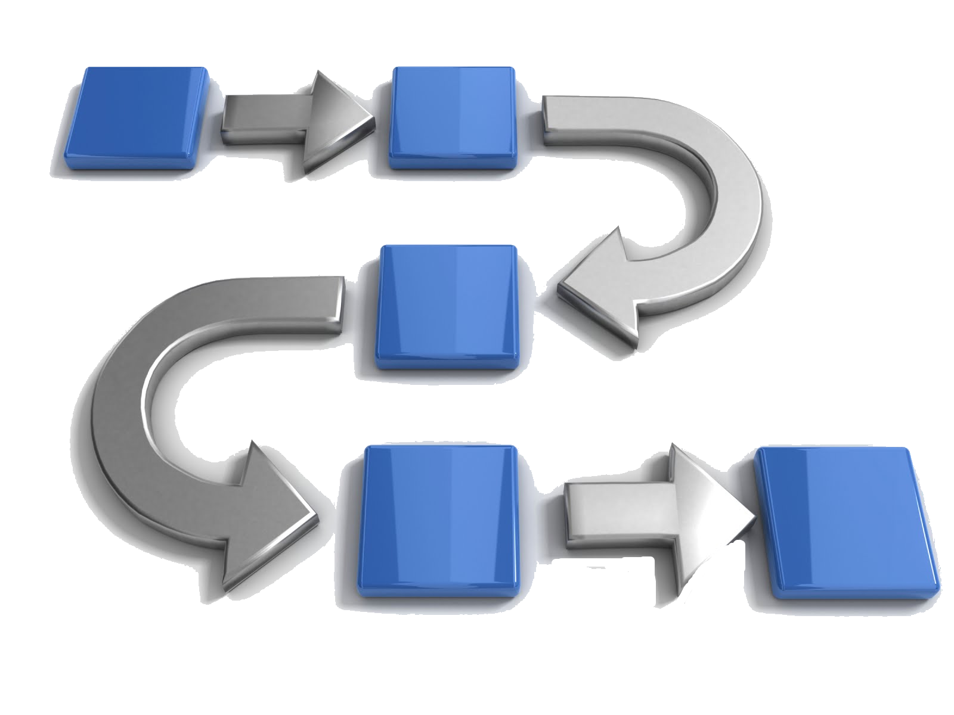
Methodology
1.Judge pattern
Take a moment to find which pattern suits the question.
2.Solve
Use the pattern to solve the question.
3.Compare
Compare Control Flow Graphs.
Edit Operations
Adding a node or edge.
Deleting a node or edge.
Notes:
This is the methodology that resulted in us obtaining our data.
Our approach was purely manual, it required a lot of human effort to complete.
When we start a question, we first take a few minutes to judge which pattern is best suited to solve the question.
We then apply this pattern to solve the question.
Once it was accepted by the judge system, we compared the solution to the pattern we previously selected.
Our first comparison was based off our intuition., which is the initial selection we made at the start. We judge whether our initial selection was the correct way to solve the question.
To support our intuition, we needed a numerical value. To obtain this we counted the number of edit operations, which are the addition and/or deletion of code, to transform a piece of code into another.
We used Control Flow Graphs to obtain the value. We created CFGs for every pattern, and compared these with the solutions. In this case we were counting how many nodes and/or edges we needed to add or delete.
Each operation was given a value of one.
We totalled the edit operations, if the number was below 10 then they were similar. If it was above 10 then they were dissimilar.

Slide 7
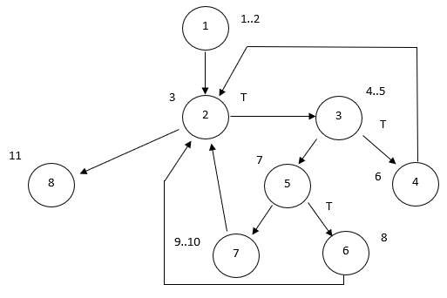
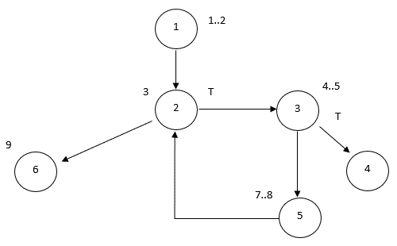
Concrete Example
CFG for Palindrome Algorithm
CFG for TwoSum question on LeetCode
Notes:
Here I give an example of how CFGs are used to judge similarity between a pattern and solution.
The first is the standard algorithmic pattern, Palindrome.
It contains 6 nodes and 6 edges. A total of 12.
The second is the question TwoSum. We solved it using the Palindrome Algorithm, which was based on our initial intuition when we first read the question.
To back up our intuition this CFG has 8 nodes and 10 edges, a total of 18.
Comparing the two we see that 6 edit operations would be required to transform one into the other. 2 additional nodes and 4 additional edges.
Therefore, the solution to TwoSum is related to the Palindrome Algorithm.

Slide 8
Results
Notes:
Here is the total data for the 36 questions that we solved. I have split the data up into two smaller graphs.
The first graph shows the frequency of each pattern that we focused on out of the 36 questions completed.
Tree traversal appeared 6 times, Palindrome appeared 5 times. This was a total of 11, which was roughly 30% of the questions alone.
The total here is 21 appearances. The other 15 solutions were solved without using any of the algorithms we chose to focus on, or none. We did notice that some of the questions that were answered used Insertion Sort for example.
Secondly, I am showing the frequency of the data structures that were used in the solutions. Arrays were clearly used the most. This shows that even in complex situations, arrays are powerful.
Combining these two tables results in the full table which can be found in the paper in the evaluation section.

Slide 9
Conclusions & Future Work
Conclusion
Future Work
Readers learn that the patterns for standard algorithms are flexible.
Understanding the standard algorithms is useful for interviews.
The approach taken was manual, which was close to the interview experience.
Pilot study for future improvement.
Machine learning.
Develop an automatic validator of similarity.
Notes:
Conclusion:
Overall there is a clear link between interview questions and standard algorithms that readers will have learned in a programming course. Of the 36 questions, 21 had a pattern that we chose to focus on appear. This is roughly 60%. This number would be increased if we consider other patterns.
We’ve shown that by learning these standard algorithms, a programmer can use them to answer a variety of questions, some which are outside the norm relating to each identified algorithm.
We’ve also shown that by spending more time on the patterns of each algorithm, a user should be able to then answer more interview questions, as they have a deeper understanding of the patterns and their flexibility.
Our approach in this paper was manual. We solved each question ourselves. This means our approach was close to the interview experience itself, as both have a human aspect.
Future Works:
This thesis is an initial study into the link between interview questions and standard algorithms.
We see the following two improvements as good future work:
Machine Learning techniques could be utilised to quickly predicate which algorithmic pattern would be best applied to a given interview question.
It would be useful to develop an automatic similarity validator for comparing some given solutions for questions, to the standard algorithms’ patterns.
Any future work would have to consider more questions and from a wider range of topics too.

Slide 10
Questions
Notes:
The Problem:
To be able to tackle the problem of helping interviewees prepare better for interviews, we first have to know where the industry was.
We found interview preparatory books to be closely related, i.e. “Cracking the Coding Interview” by Gayle Lackmann.
These books have sections candidates should prepare for interviews, such as Searching, Sorting, Recursion.
These are useful as they have some questions on each topic area along with suggested solutions.
But we find these to be an inefficient use of time, as a candidate can not prepare 50+ questions before an interview.
There would be overlapping ideas that should be focused on more.
Ex: If there are 4 questions solved using MergeSort, they all share common key steps. But if the book does not show that the same steps are taken, only altered to suit the question, then the book is limiting the readers’ ability to think outside the box and apply the patterns in different ways.
Our approach is to show the reader that being comfortable with the patterns will result in them being flexible in thought, such that readers can apply a standard algorithm to multiple questions and not just limited cases. We want to reinforce material they would be familiar with.

